Slide 1
Internet of Things (IoT)

Slide 2
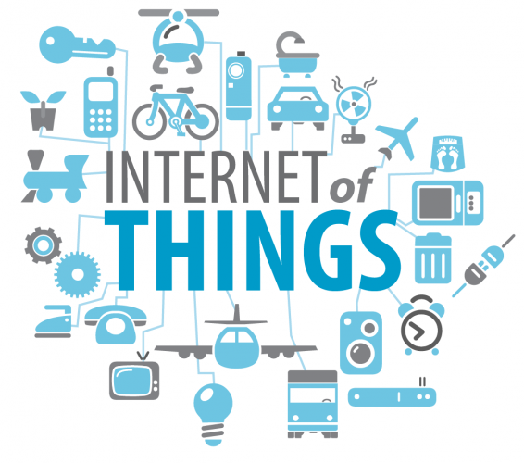
Internet of Things (IoT)
Network of physical objects or “things”
Objects exchange data with other connected devices without human intervention
Embedded with electronics, software, sensors, and connectivity
By 2020, it is estimated that the IoT will consist of almost 50 billion objects

Slide 3
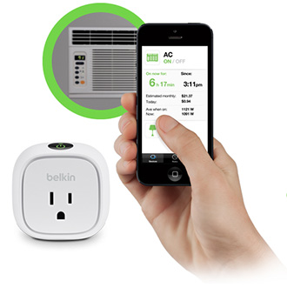
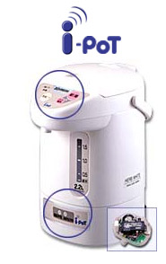
Internet of Things (IoT)
Smart power outlet (Belkin Wemo)
Smart home appliance (Zojirushi I-Pot)

Slide 4
IoT Components
Sensing
Communication (wireless)
Data analytics

Slide 5
Sensing
Detect events
Detect changes in environment
Acoustic: microphone
Chemical: carbon dioxide, smoke detector
Position: accelerometer sensor
Light: photo-detector
Pressure sensor
Heat sensor
Proximity sensor
Notes:
Accelerometer: sense the acceleration force (of the gravity)
By measuring the amount of static acceleration due to gravity, you can find out the angle the device is tilted at with respect to the earth.

Slide 6
Sensing
Connect distance sensor to the Arduino Uno
https://www.youtube.com/watch?v=PnJnbDfLr3M
https://www.youtube.com/watch?v=DTUUKM--PyQ

Slide 7
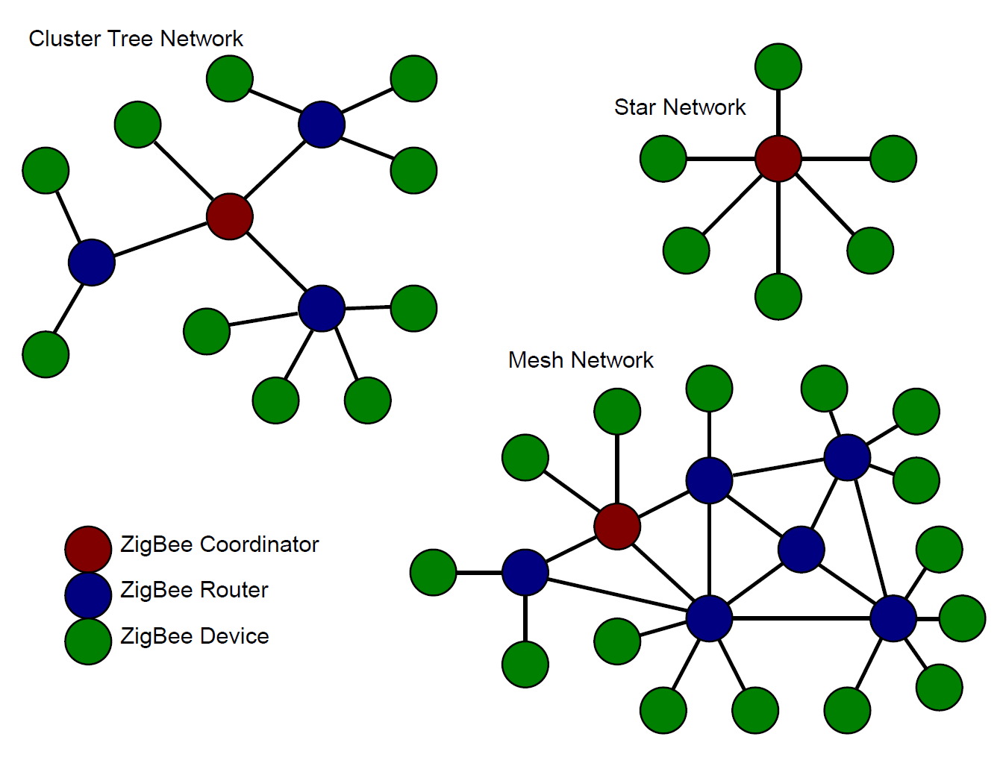
Communication (Wireless)
Wi-Fi, Bluetooth, Zigbee, Z-Wave
Wi-Fi
High-bandwidth
Power-intensive
Wi-Fi chips are relatively expensive
ZigBee
Low bandwidth
Low data transfer speed
Low power-consumption rate and long battery life
Notes:
Zigbee: last for weeks or months

Slide 8
Data Analytics
Classification
Given a new observation as input, predict the class / category that the observation belongs to
  Based on an email header / content, predict if it is a spam or not
  Based on the student’s body temperature, heart-rate, predict if the student is under stress
Regression
Given a new observation as input, predict the real-value output for the input
  Given the profits of a company in the previous years, predict the profit of the company in this year
  Based on student’s quizzes score, predict his/her exam score

Slide 9
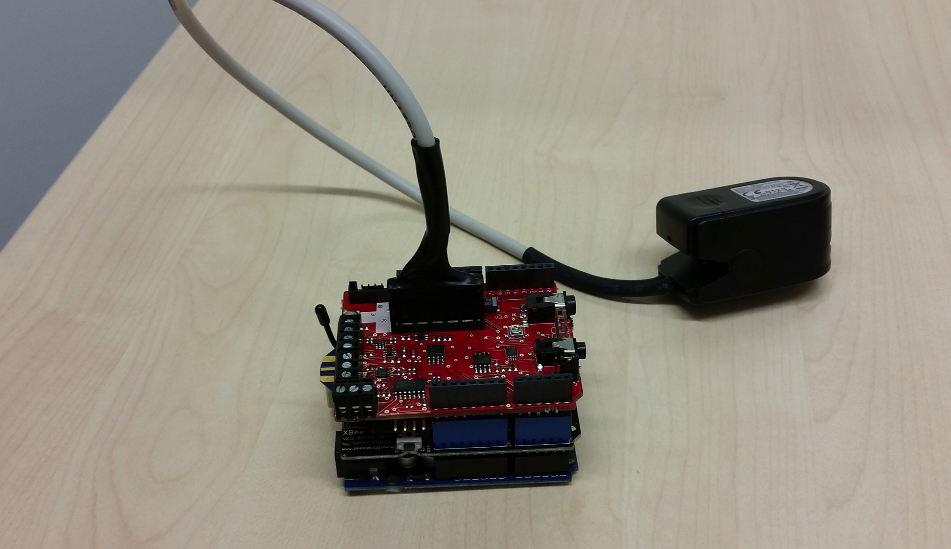
Equipment we will use
Health sensor
Sensor data
Zigbee communication module
Health sensor module
Arduino Uno

Slide 10
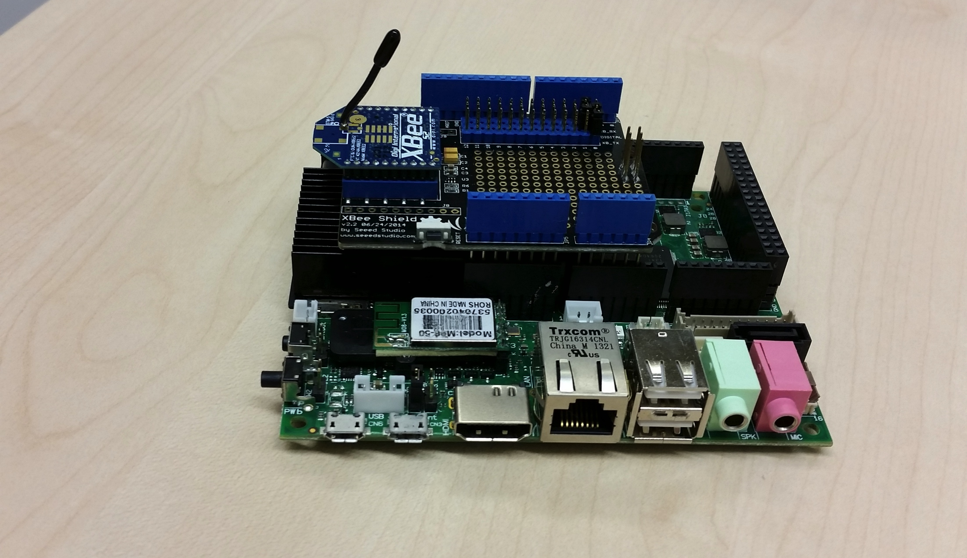
Equipment we will use
Sensor data
Zigbee communication module
Udoo Controller
Java based data analytics on Android-based platform
Arduino Due

Slide 11
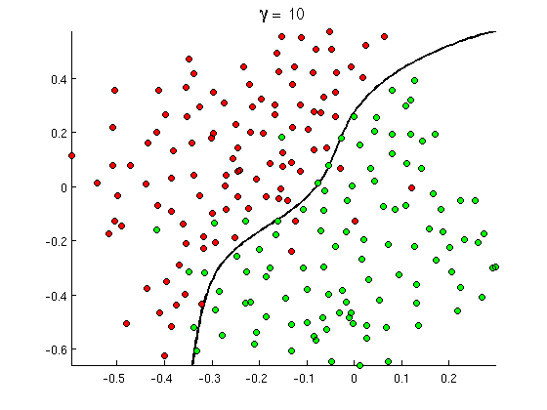
IoT in ISTD 50.001
IoT concepts and applications
IoT framework, programming, software design
  Java and Android
  Communication between IoT devices and controllers
  Fundamental IoT software development skills, basic Arduino programming
Basic data analytics for IoT
  Regression, classification

Slide 12

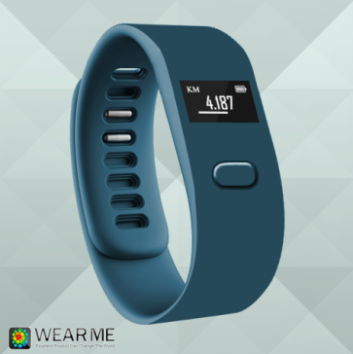
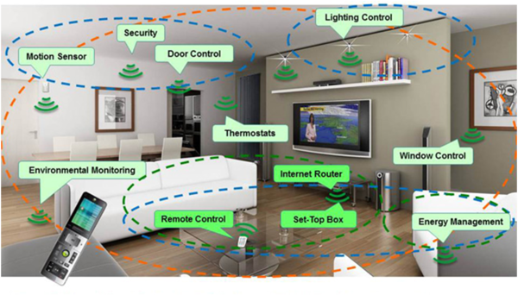
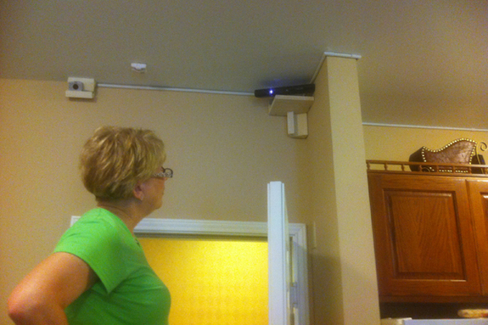
IoT Design Project
Students work as teams to use IoT to solve some open problems
  IoT for smart classroom
  IoT for smart campus
  IoT for smart home
  IoT for smart care-at-home
  …

